Slide 1
What makes a good essay?
Preparing your students for U4

Slide 2

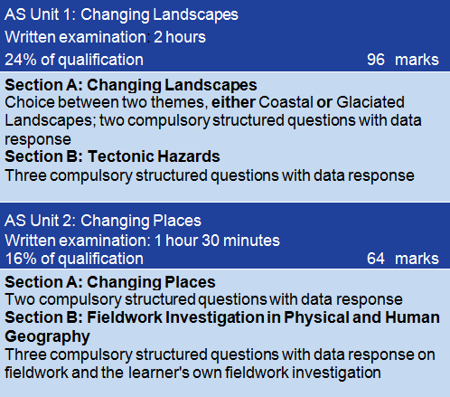
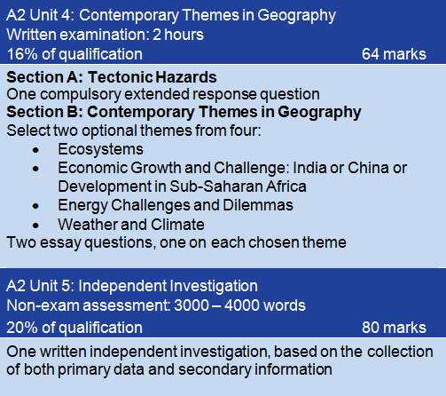
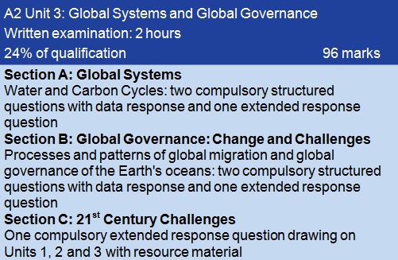
Assessment structure of A level:
U4 examination carries 16% of A level marks –The examination comprises three extended response questions
Notes:
If you followed WJEC specifications previously, you will be familiar with the previous marking structure where essays were marked out of 25 marks – the focus was not on specific AOs when applying the mark scheme. This has now changed and the new marking structures (split into all three AOs) will be rigorously applied. Your students will NEED to understand this as they plan their essays.

Slide 3
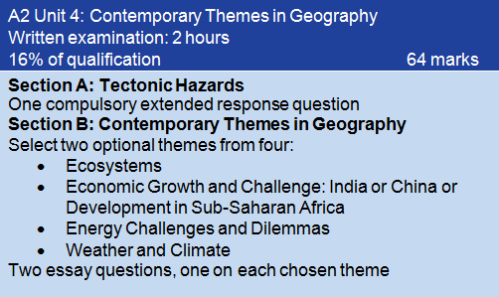
The U4 examination comprises….
One Tectonic Hazards essay from a choice of two - 20 marks
Two Contemporary Themes essays, each from a choice of two – 22 marks

Slide 4
Ensure that your students understand the assessment objectives
Unit 4 |  |  |  | TOTAL MARKS = 64
Section A | AO1 | AO2 | AO3
Tectonics | 6 | 13 | 1 | 20
Section B | AO1 | AO2 | AO3
Option 1 | 9 | 11 | 2 | 22
Option 2 | 9 | 11 | 2 | 22
AO1 Knowledge and understanding
AO2 Application of knowledge to interpret/analyse/evaluate
AO3 Use of qualitative skills to construct arguments and draw conclusions
Notes:
The weighting of each AO differs between Section A and Section B but the most significant number of marks are consistently awarded for the application of knowledge and understanding to interpret, analyse or evaluate geographical information (AO2). The quality of the argument constructed is dominant in Section A whereas more in-depth knowledge and understanding of the themes chosen (AO1) should be displayed in Section B.

Slide 5
Exemplar essay from Student Guide:
‘To what extent is the quality of governance the most important factor in the recovery of countries and communities from tectonic disasters?’ [20 marks]
AO1 Knowledge and understanding
AO2 Application of knowledge to interpret/analyse/evaluate
AO3 Use of qualitative skills to construct arguments and draw conclusions
Notes:
In the zip file that accompanies this PowerPoint you will find a Tectonic Essay Exemplar from Student Guide 3. This essay will be used to illustrate the importance of achieving a balance between knowledge and understanding (AO1) and application (AO2) in response to the marks available.
This response will also illustrate the progression that candidates will need to make as they move from the AS to A Level Units, turning 8 mark responses (AO1 weighted) into AO2 weighted extended responses and essays.

Slide 6
Exemplar essay from Student Guide:
‘To what extent is the quality of governance the most important factor in the recovery of countries and communities from tectonic disasters?’ [20 marks]
AO1 Knowledge and understanding
AO2 Application of knowledge to interpret/analyse/evaluate
AO3 Use of qualitative skills to construct arguments and draw conclusions
Notes:
Red identifies the AO1 elements of the question, green the AO2.

Slide 7
Exemplar essay from Student Guide:
‘To what extent is the quality of governance the most important factor in the recovery of countries and communities from tectonic disasters?’ [20 marks]
AO1 Knowledge and understanding
AO2 Application of knowledge to interpret/analyse/evaluate
AO3 Use of qualitative skills to construct arguments and draw conclusions

Slide 8
Exemplar essay from Student Guide:
‘To what extent is the quality of governance the most important factor in the recovery of countries and communities from tectonic disasters?’ [20 marks]
AO1 Knowledge and understanding
AO2 Application of knowledge to interpret/analyse/evaluate
AO3 Use of qualitative skills to construct arguments and draw conclusions

Slide 9
Exemplar essay from Student Guide:
‘To what extent is the quality of governance the most important factor in the recovery of countries and communities from tectonic disasters?’ [20 marks]
AO1 Knowledge and understanding
AO2 Application of knowledge to interpret/analyse/evaluate
AO3 Use of qualitative skills to construct arguments and draw conclusions
Notes:
The AO2 element is largely steered by the command word (stem). This is what will tell candidates how to answer the question, but candidates should remember that key and specialised concepts could give their discussions a framework that will be given credit. Reference to applicable key or specialised concepts (implied or explicit) will be credited.
Key concepts: place, space, scale (temporal and spatial) and environment
Specialised concepts: causality, equilibrium, feedback, identity, inequality, interdependence, globalisation, mitigation and adaptation, representation, risk, resilience, sustainability, systems, and thresholds

Slide 10
Ensure that your students understand each of the four U4 commands
U4 commands
Discuss | Goes beyond knowledge and understanding to offer a considered review that includes a range of arguments. It becomes a written debate, identifying through description and explanation, both positive and negative points and reaches a conclusion from the debate.
Evaluate | Goes beyond knowledge and understanding to evaluate. Requires a judgement about the overall quality or value of the feature(s)/issue(s) in terms of the strengths and limitations. Supporting evidence should be clearly given.
To what extent….? | Goes beyond knowledge and understanding to give possible explanations for and against, and justify a viewpoint(s).
Justify | Goes beyond knowledge and understanding to explain why the choice given is better than other possible options.
Notes:
The AO2 element is largely steered by the command word (stem). This is what will tell candidates how to answer the question, but candidates should remember that key and specialised concepts could give their discussions a framework that will be given credit. Reference to applicable key or specialised concepts (implied or explicit) will be credited.
Key concepts: place, space, scale (temporal and spatial) and environment
Specialised concepts: causality, equilibrium, feedback, identity, inequality, interdependence, globalisation, mitigation and adaptation, representation, risk, resilience, sustainability, systems, and thresholds

Slide 11
Exemplar essay from Student Guide:
‘To what extent is the quality of governance the most important factor in the recovery of countries and communities from tectonic disasters?’ [20 marks]
AO1 Knowledge and understanding
AO2 Application of knowledge to interpret/analyse/evaluate
AO3 Use of qualitative skills to construct arguments and draw conclusions
Notes:
AO3 qualitative skills could include the skill of presenting a well-constructed, ordered, logical argument, constructing relevant diagrams or sketch maps in support, or the skill of reaching conclusions. The candidate does not have to include a concluding paragraph to gain full marks for AO3 – conclusions could be ongoing.

Slide 12
Unit 4 Band 3 descriptors:
AO1 (6 marks ) | AO2 (13 marks) | AO3 (1)
Developed factual knowledge; confident understanding of concepts and principles Developed exemplification with supporting geographical terminology Well-directed and well-annotated sketch maps Spelling, punctuation and grammar used with a high degree of accuracy | Accurate application of knowledge and understanding to analyse, interpret or evaluate Synthesis of the connections between different elements of the response to the question Relevant application of the specialised concepts | The response is appropriately structured
Notes:
These are the requirements for reaching the top band in Section A.

Slide 13
Marking exercise 1:
Using the mark scheme and band descriptors provided, decide on an appropriate mark for AO1, AO2 and AO3 for the sample essay.
Suggest three ways in which this essay could be improved.
Section A | AO1 | AO2 | AO3 | Total
Tectonics | 6 | 13 | 1 | 20
Notes:
Print out ‘Tectonics Essay Pack’ from the zip file. This file contains the essay, indicative content guidance and a copy of the generic mark bands for this essay in Section A of Unit 4.
Attempt to give the essay an appropriate mark for each of the three AOs before discussing three ways in which you could improve this essay.

Slide 14
Marking exercise 1:
The Principal Examiner awarded this essay the following marks:
Section A | AO1 | AO2 | AO3 | Total
Tectonics | 3/6 | 3/13 | 1/1 | 7/20

Slide 15
How could this response have been improved?
Although the response is factually sound (AO1) there is very little knowledge and understanding of the role of good governance shown. The response could also have been extended to cover recovery from volcanic eruptions (AO1).
The candidate has not successfully addressed the command ‘To what extent is good governance the most important factor?’ (AO2). This could have included explicit reference to other factors which can affect risk and vulnerability to earthquakes e.g. economic development, population profile, rural/urban location etc.
Reference to and understanding of risk or mitigation as relevant specialised concepts has not been sufficiently developed (AO2)
The response is logically structured but does not come to a coherent conclusion to evaluate the role of good governance in the recovery of communities (AO3)

Slide 16
Tackling AO2……..
Students should be able to identify relevant concepts in each essay question. Display these clearly in the classroom and refer to them often – enable the students to identify these as strands that run through their A Level studies
Students should identify the command word and create a debate around it
Identify the command
Identify specialised concepts
Use evaluative language
Synthesise knowledge
Using contrasting or evaluative language can help focus students on AO2. ‘However’, ‘on the other hand..’, nevertheless..’, ‘ as opposed to…’ and ‘yet’ are very useful tools
Draw knowledge together to reach rational conclusions to the argument or debate. Use appropriate language e.g. ‘in conclusion…’ ‘in summary…’
Notes:
Candidates will need to develop the toolkit to respond to the AO2 element in each of the three essays in Unit 4. Above are some suggestions that could provide a framework for developing this skill.

Slide 17
Now, mark like an examiner………
The zip file contains eight further essays, one from each U4 theme and extra Weather and Climate and Energy essays to enable you to view a range of marks for the same essay
Each essay includes full examiner commentary at the foot of the essay to illustrate the application of the U4 mark scheme
These essays are candidate materials from previous examination cycles. Bear in mind that the command words used may vary from those that candidates can expect in U4 examinations. The essay titles used in these exemplars can be easily adapted to incorporate the appropriate U4 command words
If you have any further questions, please contact your Subject Officer for GCE Geography at erin.roberts@wjec.co.uk

