Slide 1


CLOSED BOOK, OPEN MINDS

Slide 2

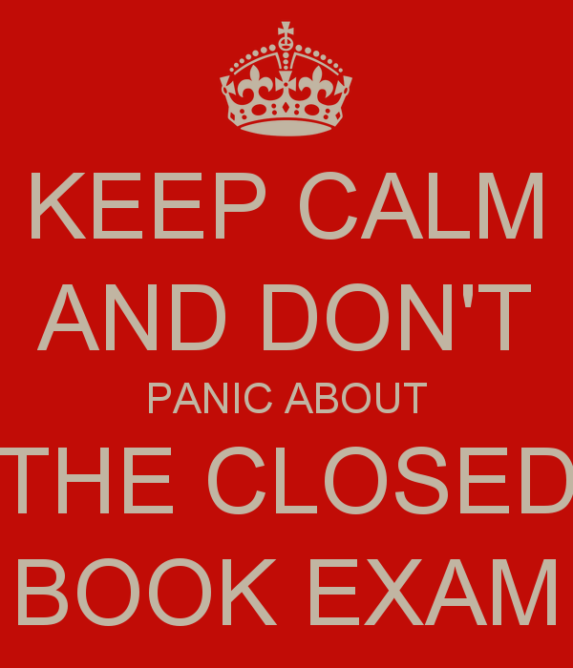

Slide 3
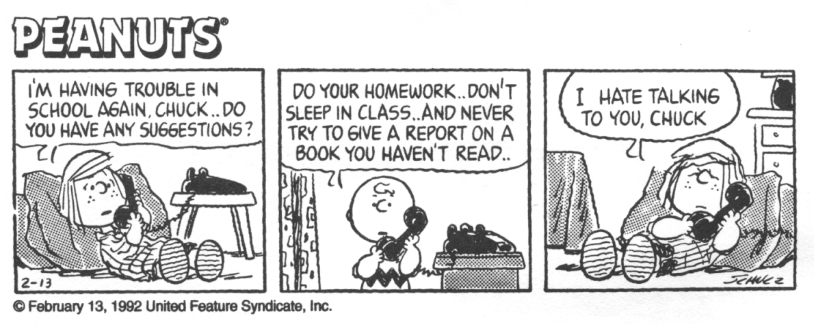

Slide 4
Closed book exam, not closed book course...
Reading the whole text, perhaps with annotations and/or notes made to complement this reading, is the first priority.
Nothing wrong with teacher reading aloud. Most people love being read to. If sharing reading with students, choose carefully - not everyone enjoys reading aloud. Try having students to read dialogue in novels.
Plays a different matter - need different voices, so choose carefully. In a part of the play with complex stage directions, get someone (or yourself) to read them out, whilst nominated “characters” act out the movements, and, perhaps, someone else reading the dialogue.
With Shakespeare, read whole text, but with range of techniques: punctuation mark to punctuation mark, focus on last words on lines. RSC and other companies a valuable resource here.

Slide 5
It’s better to tackle film versions head on, as students will access them one way or another, so use them constructively. Discuss similarities and differences, and the reasons for this. In order to secure knowledge devise “tests”: film or text? True or false?
Throughout, keep the discussion going, with an eye on the relevant AOs, so it’s second nature, built up gradually.

Slide 6
Chunking up the text
The next stage is to guide students into focusing on key sections of the text, by dividing it into stages: five or six should be enough. Could divide the story into separate installments or episodes, then consider what would be the key point or climax in each episode. Which characters feature most, and why? Find a key quotation for each episode, perhaps to serve as a title.
Groups could create freeze frames of key moments, with the rest of the class identifying and contextualising the moment, and choosing the best quotation as a caption.

Slide 7
Focus on Characters
Place characters in order of importance at different stages of the text, and trace their changing relationships and the reasons for these changes. Find key quotations for each stage in a character’s journey.
Stanislavski type approach: if character were an animal/bird, insect, what would they be, and why? If they were a flower/tree what sort would they be and why?/what car/drink/food would they be and why? choose a symbol to represent them/what is their chief motivation?/a brief quotation to sum them up etc. etc. Present as a poster.
Once the main characters have been clearly grasped, move on to minor characters. How and why are they important?

Slide 8
Also with characters, “cast” them from well known actors or personalities, always with clear reasons provided for choices.
As an extension, make a “musical” from the text: songs from key moments to highlight characters/themes/mood and atmosphere.

Slide 9
Themes
Brainstorm themes and how they are evident at different points in the text. Place themes in order of importance.
How are themes presented through parts of the plot, locations, characters?

Slide 10
Get to detail
Working in groups, create boardgames/quizzes based on the text, e.g. on the lines of Who Wants To Be A Millionaire?, Snakes and Ladders, Pointless etc. or students may invent their own. Groups can then try out each other’s games/quizzes.
“Just A Minute” on set text, speaking without repetition, hesitation or deviation.
“Interviewing” writer re his/her text, probing content, intentions and stylistic decisions.
Tests (possibly devised by students): taking format of a short quotation (e.g. no more than four lines of a play, or a couple of sentences from a novel) with three or four questions, on the lines of:
who spoke these lines?/what is going on here?
to whom?/what has just happened/is about to happen?
explain the meaning/ significance of .....
This will reinforce students‘ detailed knowledge and understanding of the text.

Slide 11
The exam....
Share the indicative content marking guidelines from the Specimen Assessment Materials and have students devise their own indicative content for various questions in the style of the ones in the Specimen Assessment Materials.
By this stage, no need to learn by heart, as knowledge and understanding will have been assimilated....
This is by no means an exhaustive list, of course.....

Slide 12
GCSE English literature – learning and understanding, not memory
Glenys Stacey, 18 March 2015 – A levels and GCSEs
I am sure many of you will have seen comments in the media over the past few days about the benefits or costs, practicalities or need for students to memorise poetry as part of their secondary school education. This debate appears to have grown from a misunderstanding about the assessment requirements of the reformed GCSE English literature exam. So let me take a moment to set the record straight so that the debate can continue in a more informed way.
Some commentators are arguing that students will need to learn poems by heart to succeed in the reformed exam, but that is simply not true. Rather, it is a deep understanding and breadth of reading that will get students good marks.

Slide 13
The content requirements produced and published by the Department for Education require that students’ study ‘whole texts’. These can range from an anthology of poetry to lengthy novels. The Department also requires students be able to critically compare these texts using ‘relevant quotation and detailed textual references’.
In order to access higher grades students will therefore need to be able to show that they are familiar with the texts – that they have studied them – and their understanding be sufficiently developed to be able to compare them with other texts that might be presented. But there is no expectation that students should have to regurgitate paragraphs of text in the exam. Assessment is about learning and understanding, not memory.

Slide 14
Reading and writing about unseen poetry........where to start?
Before starting writing about a poem in detail, read and re-read it, ideally underlining and annotating as you go.
Reading it three times is a useful rule of thumb: once (very briefly) for the gist, once for sorting out what it’s about (its “story”) and once for details and effects.
You may well find your initial opinions alter once you’ve read the poem a couple of times.

Slide 15
Points to think about during these initial readings:
Take note of the title: it may be perfectly self explanatory, or it may carry a deeper meaning. Either way, it usually gives a useful lead.
What is the train of thought? The best way to determine this is to track through systematically, reading in units of sense, not line by line. It’s usually useful to read from punctuation mark to punctuation mark, which will help break the poem into units of sense. NEVER UNDERESTIMATE THE END OF A POEM! Often the poet’s key message comes towards the end of the poem, so it’s important to be thorough.
Is there are specific voice? If so, whose? Poets sometimes write as if they were a different character ( sometimes called the persona ), although often they write as themselves, too. In either case, what is the effect of the voice?

Slide 16
Is it addressed to someone? Love poems, for example, sometimes use the second person ( “you” ) which can create a very intimate feeling. If the poem is addressed to a specific person, what is the effect of this?
What is the aim of the poem? Does it, for example, tell a story, describe an experience, protest about something, describe a place? Try asking yourself why the poet wrote the poem.
What is its mood and atmosphere? Does it change at all? How do you know? Pinpoint words and phrases that help create the mood and atmosphere. ( If you’re a bit stuck, some people find it helpful to think in terms of the sort of music or colours that would provide a background to the poem. )

Slide 17
Focus closely on the words used, and their effects.
Is there any distinctive imagery, and what are the effects of any imagery used?
NEVER “SPOT” TECHNIQUES ( “There is a simile in the second stanza” ) without showing how the technique contributes to the overall meaning/theme(s)
Remember that points must be proved with evidence, and then discussed/ explained. There is no “correct” answer, but a reading and interpretation needs to be carefully supported.

Slide 18
What about the way the poem is put together, or organised - the lengths of lines, significant pauses, the use of stanzas, any distinctive rhythm or rhyme? Again, don’t spot, but explain how what you select fits in with the overall meaning.
What is your personal response? Does it, for example, connect with any of your own experiences or anything else you’ve read or seen?

Slide 19
Postscript
And some time make the time to drive out west Into County Clare, along the Flaggy Shore, In September or October, when the wind And the light are working off each other So that the ocean on one side is wild With foam and glitter, and inland among stones The surface of a slate-grey lake is lit By the earthed lightning of flock of swans, Their feathers roughed and ruffling, white on white, Their fully-grown headstrong-looking heads Tucked or cresting or busy underwater. Useless to think you'll park or capture it More thoroughly. You are neither here nor there, A hurry through which known and strange things pass As big soft buffetings come at the car sideways And catch the heart off guard and blow it open.
Seamus Heaney

Slide 20
And finally…..
“Unseen poetry is great. There’s no wrong or right answer as long as you can justify it.”
2015 English Literature candidate, on social media.

