Slide 1


GeogShots
CC BY-NC-ND 4.0

Slide 2
GeogShot.
A 10-minute solution focused “shot” of geography to help guide your learners to more successful responses in the exam.
They are designed so you can fit these resources into your existing lesson plan or adapt as you want.
Each builds on identified actions from examiners reports.
They could be part of your intervention strategy to support and challenge your learners in class.
They are designed to allow you to insert a relevant question to work on from any aspect within the specification.

Slide 3

It is important your learners know the demands of the different assessment objectives and how to recognize the requirements they have to demonstrate in their response to exam questions.
How can this be included in your lesson?
CC BY-SA 3.0
Notes:
Ideas on how to use these slides in your lesson is included in the notes these are just suggestions and the idea is this is flexible for you to edit and use as you would want to.

Slide 4
AO1.1 Demonstrate knowledge of places, environments and processes at a variety of scales
AO1.1 (15%)
Knowledge of aspects of subject content
Candidates will be asked to recall knowledge of:
Locations
  Places Processes
Environments
Generally low mark tariffs.
Typical command words for AO1.1 might include:
Describe Give
Define Outline
Identify
Notes:
Build into your lessons the understanding of the demands of AO1.1 the learners need familiarity with command words to signpost the demands of the question. Consider the amount of time required to answer these low tariff questions and ensure accuracy. Ask these questions when you introduce the question in the class.

Slide 5
Questions using AO1.1 may assess
knowledge of key terms
identifying correct statements
giving main characteristics of a feature
Notes:
This is the nature of the types of questions that are used to assess this objective, learners' knowledge and practice of these will help effective responses in the exam situation.

Slide 6
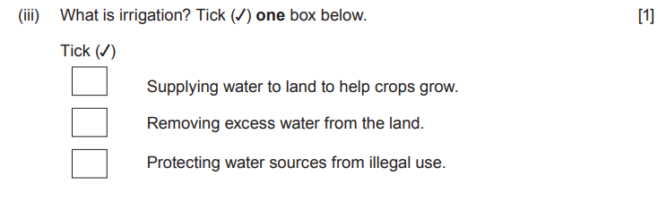
knowledge of key terms
Give two limitations of using Total GDP as a measure of economic development. [2]UNIT 2 2018
Questions using AO1.1
identifying correct statements
UNIT 2 2018
Landscapes are often affected by people. Describe one negative impact of people on a landscape you have studied. [3] UNIT 1 2018
giving main characteristics of a feature
Notes:
Use this slide to identify the type of question your learners will need to identify in the exam. To gain these identification skills use these techniques regularly in class.

Slide 7
Geography content need to be specific on how abrasion works at eroding the river. Use technical words in your answer.
AO1.1 Demonstrate knowledge of places, environments and processes at a variety of scales
The process of abrasion takes place in the Afon Dulais. Describe this process. (2) WJEC 2022
Complete the list below with possible geographical key words you could use in the answer to this question.
Command word Describe:
Give an account of the main characteristics of something or the steps in a process. Statements in the response should be developed but do not need to include a justification or reason.
Key Words
1. load
2.
3
4.
Notes:
Give opportunities in class for learners to question the question. Consider this process a scaffold that will be withdrawn as they mature to the demands of GCSE. Several strategies can be used here BUG the question for example.

Slide 8
Identify is the command word Used for AO1.1 and AO3
The question lists features for you to name so is testing knowledge.
Which of these exam questions are AO1.1 Knowledge?
Identify one flow and one store of water in a drainage basin 2.
Identify one flow and one store of water in a drainage basin 2.
Low marks
Explain why the increasing importance of urban areas is contributing to deprivation in rural areas of Wales. 6
Give one reason why mid-Wales is mainly rural. 2
You need to explain why you think this is an AO1.1
The question names a challenge, health care and wants you to name 2 others so is testing knowledge.
Access to health care is a challenge facing people who live in remote rural areas of Wales. Describe two other challenges. 4
Access to health care is a challenge facing people who live in remote rural areas of Wales. Describe two other challenges. 4
Low marks
Describe is the command word. Used for AO1.1 and AO3
Notes:
Set up identification of the questions, but make sure learners can justify their choice to ensure they have developed understanding of the AO demands. They could also develop their own type of questions and use with peers in class.
There are hints to use with pupils to help them express why they make the judgement of AO1.1 exam question. These can be revealed after discussion and then used as a scaffold for other questions you may use in the classroom.
These questions come from Unit 1 202**

