Slide 1


GeogShots
CC BY-NC-ND 4.0

Slide 2
GeogShot.
A 10-minute solution focused “shot” of geography to help guide your learners to more successful responses in the exam.
They are designed so you can fit these resources into your existing lesson plan or adapt as you want.
Each builds on identified actions from examiners reports.
They could be part of your intervention strategy to support and challenge your learners in class.
They are designed to allow you to insert a relevant question to work on from any aspect within the specification.

Slide 3

It is important your learners know the demands of the different assessment objectives and how to recognize the requirements they have to demonstrate in their response to exam questions.
How can this be included in your lesson?
CC BY-SA 3.0
Notes:
Ideas on how to use these slides in your lesson is included in the notes these are just suggestions and the idea is this is flexible for you to edit and use as you would want to.

Slide 4
AO2 (35%) Application of knowledge and understanding.
AO2 (35%)
Application of knowledge and understanding
Candidates will be asked to apply knowledge and understanding of:
Concepts
Processes Interactions
… to a specific context provided by the stem of the question or stimulus material.
These questions have high tariff marks 4-8 and so require extended writing.
Questions assessing application will focus on the skills of:
Inference Analysis Evaluation
Making judgements
Notes:
Build into your lessons the understanding of the demands of AO2 the learners need familiarity with command words to signpost the demands of the question. Consider the amount of time required to answer these mid range to high range tariff questions and ensure development of the point. Introduce scaffolds using connective words in class develop probing questions to demonstrate how the answers can be developed to ensure reasons are clearly given to attain the demands of understanding and applying to unfamiliar contexts.

Slide 5
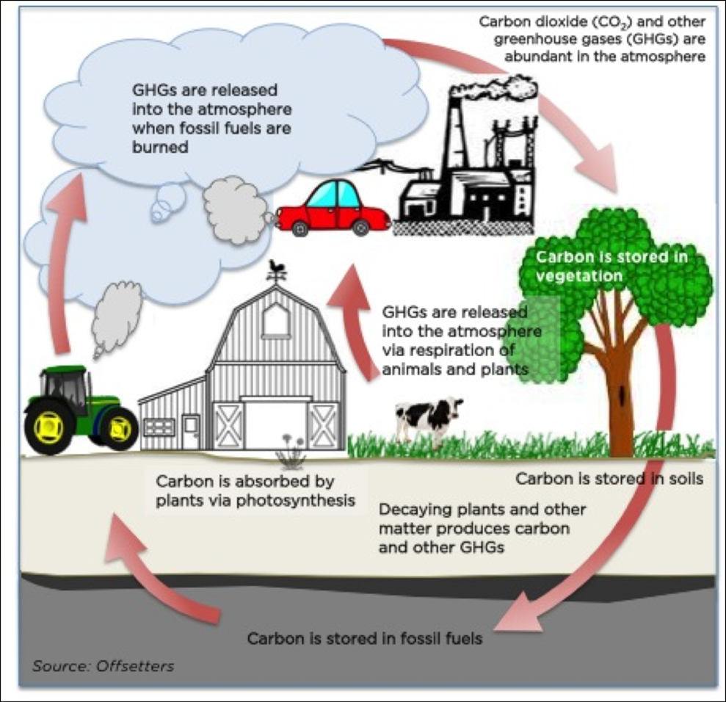

What does the image show?
What guesses can I make by putting the information together? What can you infer?
What questions do I need to ask?
GHG’s mean greenhouse gasses
Notes:
This could be used as prior to the lesson so the pupils have some possible answers already to share with the class.

Slide 6

“ To what extent” means you need to use evidence to help you make a decision.
Again, you will have either a map, graph, photo or fact box or a combination of these types of evidence.
You may never have studied this place in class but that doesn’t matter you need to recognise the geographical elements in the evidence. You will have studied somewhere else that faces a similar issue or problem.
You need to apply your understanding to help you make a decision in this new situation.
GHG’s mean greenhouse gasses
Notes:
Try to instill in the candidates the understanding that this is what do you know but how to think speak and write like a geographer to show the examiner how they can apply their knowledge and understanding.

Slide 7
‘People’s actions are the major cause of recent climate change.’ To what extent do you agree with this statement? [8]
“To what extent” question often has a diagram with labels. Don’t just copy the labels, no marks here☺
Ask your self so what… infer what may this mean?
GHGs are released into the atmosphere as a result of activities such as agriculture and so….
Establish chains of reasoning.
Notes:
Once they have interrogated the image consider de bugging the question, question the question activity.

Slide 8
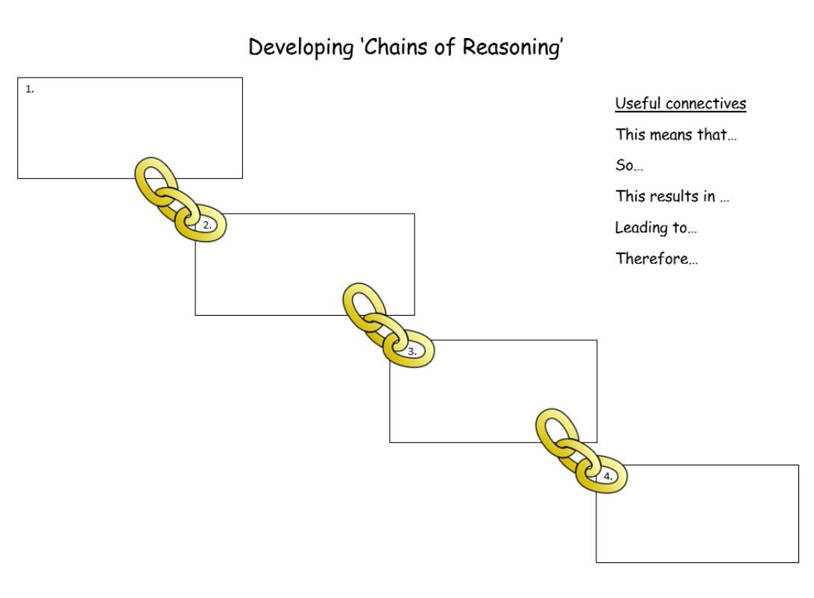
Intensive agriculture, including livestock rearing…
GHG’s released into the atmosphere
The GHG’s add to the atmosphere leading to…
Increased temperatures mean that…..
Notes:
This could be as far as you want to take the class in the classroom. Provide A 3 sheet so they can develop this in pairs then get them to move around the room to consider other pairs links.

Slide 9
An argument this paragraph will use evidence that supports the view.
Here you may argue that it is clear that the use of fossil fuels lead to climate change. Use evidence to support your points.
Structuring your answer.
A counter argument, you may argue that Over long periods of time, ice ages show that climate changes naturally, perhaps triggered by changes in the Earth’s orbit. Use evidence to support your points .
A decision, here you weigh up the evidence and reach a decision ... The evidence suggests that climate change happens naturally, but recent change is so dramatic that it is almost certainly has been caused by people..
Notes:
This is a scaffold that must be taken away once the candidates have grasped how to structure the AO2 type question.

Slide 10
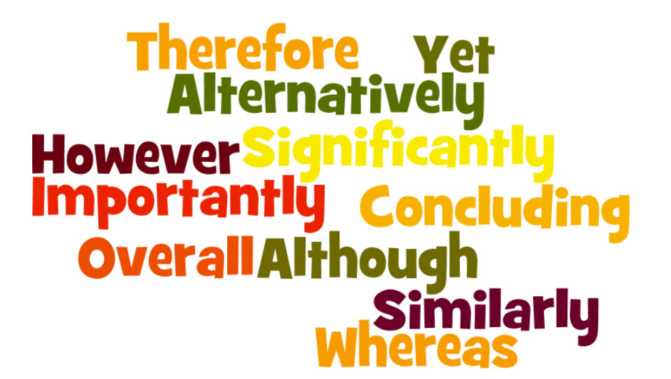
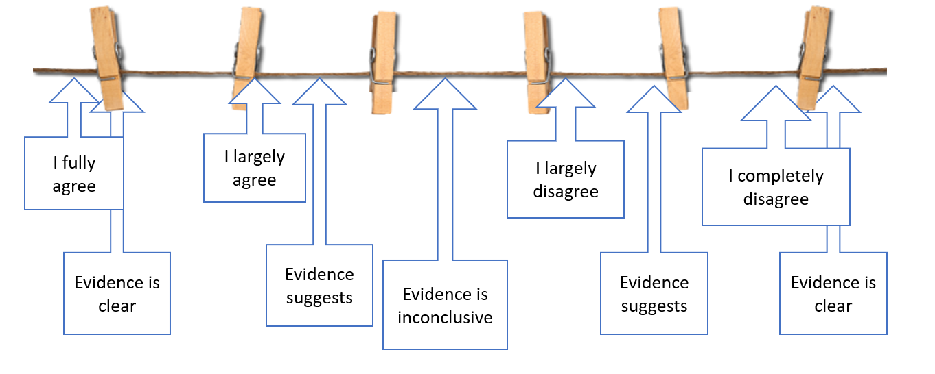
You must state whether you agree or disagree with the statement or not. It is possible that you only partially agree. The examiner is not looking for a particular yes or no. It’s the way you use the evidence to support your decision that is important.
These types of connectives can help you develop your reasons for your decision.
Or you can use the washing line to help you state your decision

