Slide 1
WJEC GCSE in Geography
Planning a programme of study for fieldwork

Slide 2
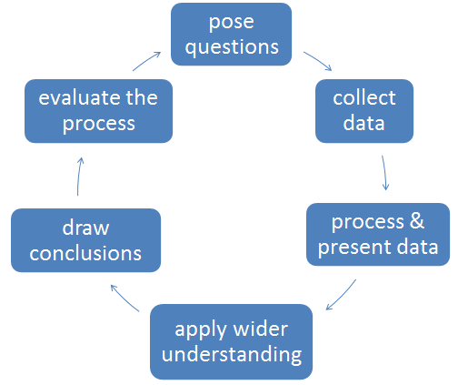
ENQUIRY STAGE 1
1 – 2 hours
This stage is about setting the overarching aim of the enquiry.
Students should be involved in posing enquiry questions and discussing a sharply focussed hypothesis that can be proved/disproved.

Slide 3
The aim will relate to the concept
A fieldwork enquiry provides opportunities for students to apply their theoretical/conceptual understanding to a real place.
Your students will need:
A conceptual context
A place context
In the first cycle, students will need a lesson on the concept of cycles and flows
They could make a virtual fieldtrip so that enquiry questions can be posed and data collection designed before the visit

Slide 4
Pose questions / set hypothesis
1 – 2 hours
Students will need to understand how a fieldwork enquiry is driven by its aims. These may be posed as:
An enquiry question
An hypothesis. Do they understand the role of the hypothesis / can they state the null hypothesis?
X is a perfect example of a modern sustainable residential community
House prices are higher closer to parks/green spaces.

Slide 5
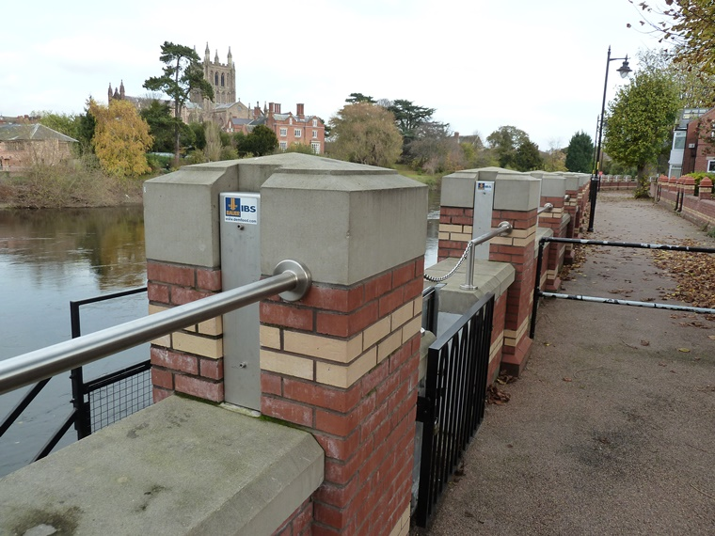
Virtual visits to pose enquiry questions
Why is the cathedral built on a hill? Is there a history of flooding? By how much does discharge vary?
Using maps, photos and data – students can conduct a virtual visit.
How do infiltration rates vary in different land uses?
Why are defences built here? What is protected?

Slide 6
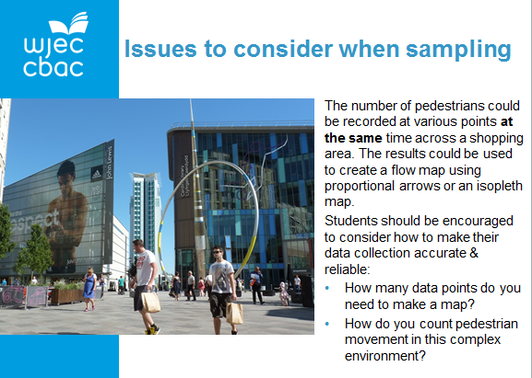
ENQUIRY STAGE 2
2 hours
Before the fieldtrip, have students had the opportunity to:
Consider different sampling procedures
Design data collection sheets
Which strategy? Justification
Teacher guidance on measuring flows is already on the WJEC website

Slide 7
Justify To give reasons for a decision based on evidence.
Evaluate To consider the strengths and limitations.

Slide 8
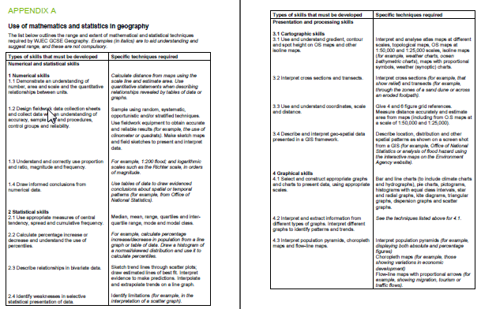
5 - 6 hours
ENQUIRY STAGE 3
Audit Appendix A. Consider which maths/stats skills are appropriate for fieldwork approaches in this cycle?

Slide 9
Can students select an appropriate technique?

Slide 10
Misleading graphs
The reading at site 2 appears to be twice that of site 1
A graph with its origin at 0 shows that the results are actually very similar

Slide 11
Justify To give reasons for a decision based on evidence.
Evaluate To consider the strengths and limitations.

Slide 12
ENQUIRY STAGE 4
2 hours
Can students apply their understanding to identify and analyse:
Patterns
Trends
Geography is about maps.
If there is insufficient primary data you can use secondary data
Trend lines on graphs showing change or scatter graphs showing correlations

Slide 13
Interpret trends
Half the scatter points on each side of the line
Dependent variable
The best fit line should go through the mean
% residents in professional occupations
Mean (M) 27.6, 17.8
The best fit line does not have to go through the origin
% residents with degrees
Independent variable

Slide 14
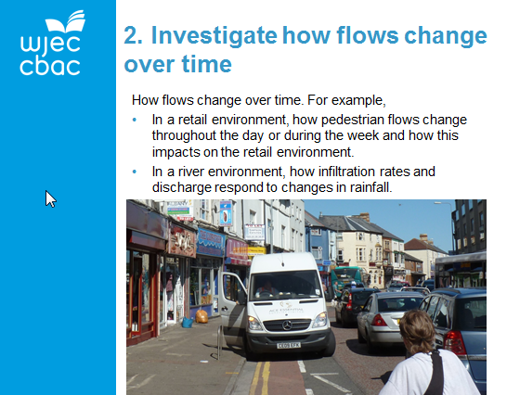
ENQUIRY STAGE 5
1 – 2 hours
Are conclusions related back to aims? Can the null hypothesis be rejected?
Does the evidence support the conclusion?

Slide 15
ENQUIRY STAGE 6
2 hours
Strengths and limitations of data collection?
What other questions are raised?
Are results accurate?
Are results reliable?
Are secondary sources biased? If so, why?

Slide 16
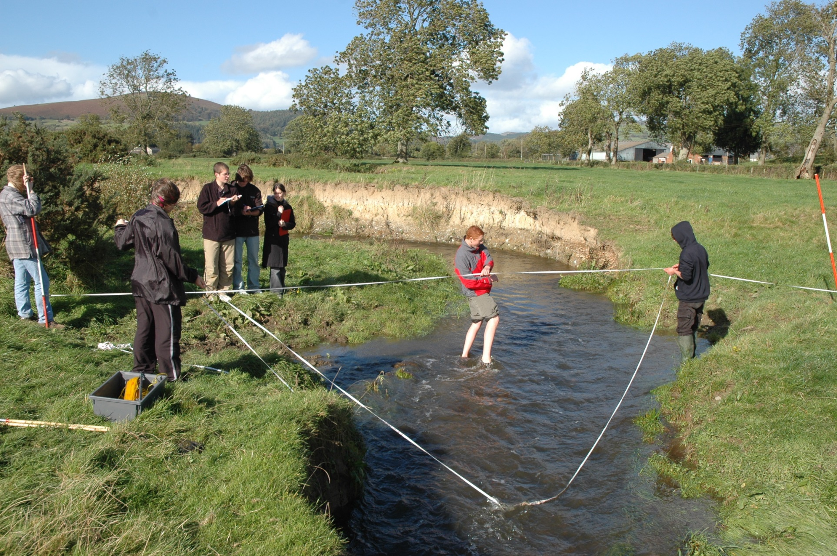
Accuracy Each measurement is made to an accuracy of 1cm.
Reliability The slack in the horizontal line that is used as the datum means that the results cannot reliably be repeated.

Slide 17
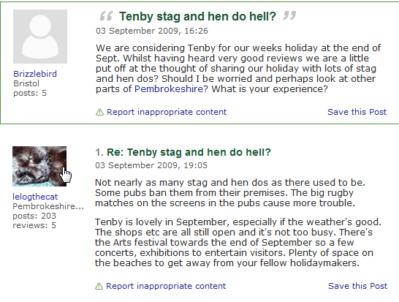
Recognising bias through text analysis
What emotive language is used?
Who has contributed? Why are they anonymous?
opinion
opinion
fact
What geographical concepts are examined?

