Slide 1


Unit 3 Fieldwork
Transects
For 2026 series (NEA Nov/Dec 2025)

Slide 2
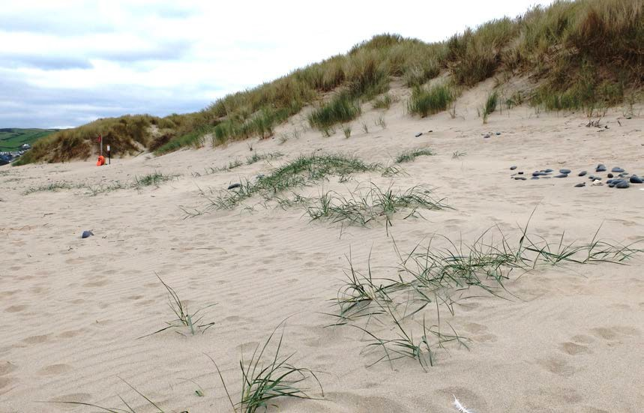
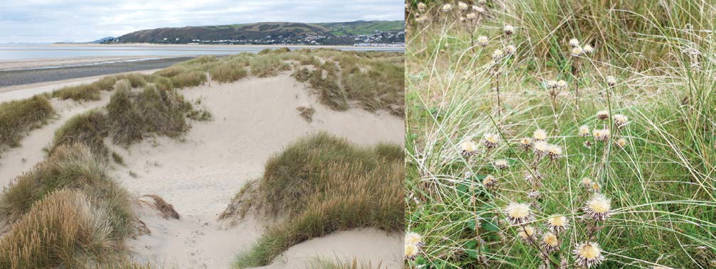
What is a transect?
A transect is a linear sampling strategy.
The survey line of a transect usually cuts across a geographical feature. As such, transects are usually positioned at right angles to the feature so that they cut across different zones, for example:
At right angles to the sea, cutting across the zones of a sand dune ecosystem
Up a slope, to investigate the affect of altitude on temperature or the relationship between slope angle and infiltration.

Slide 3

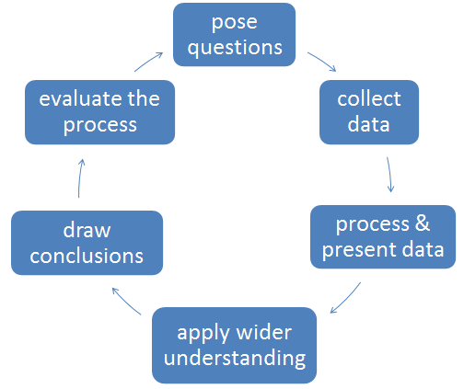
Preparation for fieldwork
Preparing for fieldwork
You must not use the school grounds for your primary data collection, but you could use them to rehearse data collection, for example, how to set out the transect or to evaluate methods of sampling along a transect.
Introduce students to the location through virtual fieldwork using online maps / aerial images to help decide where transects should begin and end / how many sample points to use.

Slide 4
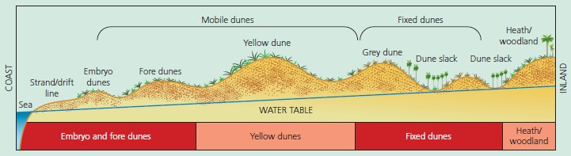
Data collection points
Sampling along a transect
Data can be collected at points along the transect. Students should be encouraged to consider:
the frequency of sampling points
whether these are chosen at random, stratified or regular (systematic) intervals
how tools, such as quadrats, could be used to sample data.

Slide 5
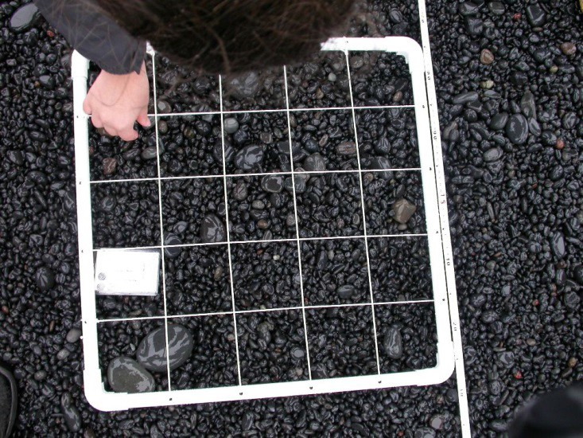
Physical data collection
Collecting physical data along a transect
A variety of physical data can be collected at points along the transect. Students should be encouraged to consider which variables may be relevant to their enquiry:
pebble size / shape / smoothness
wind speed / direction
vegetation type / height
temperature
slope angle
soil colour / texture / temperature
infiltration rate.

Slide 6
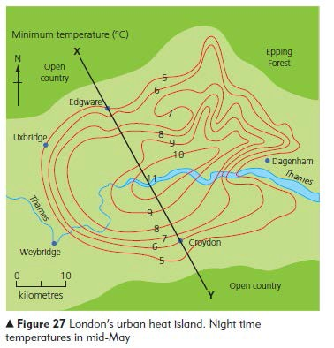
Can I do a transect in an urban enquiry?
Using a transect in an urban enquiry
The transect line could cut across
urban features. For example:
from the CBD to the suburbs, cutting across different residential zones
across an urban ecosystem such as a park or churchyard
across the CBD, taking in a variety of service, retail and leisure functions
across different land uses that are at risk of flooding (coastal or river)

Slide 7
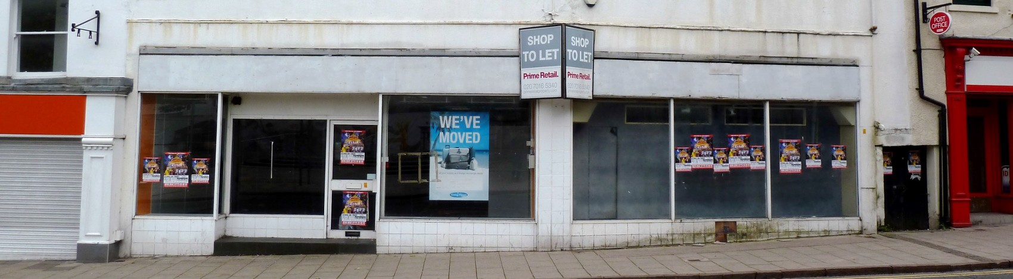
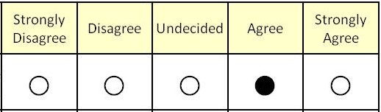
Data collection in urban enquiries
Collecting data along a transect in an urban enquiry
Data can be collected at points along the transect:
traffic counts; pedestrian flows; noise levels; land use; shop vacancies.
Data can be collected in the sectors between sample points – allowing an overview of the urban environment. This method may be more suited to:
bi-polar surveys; Likert scale surveys; recording access to services.

Slide 8
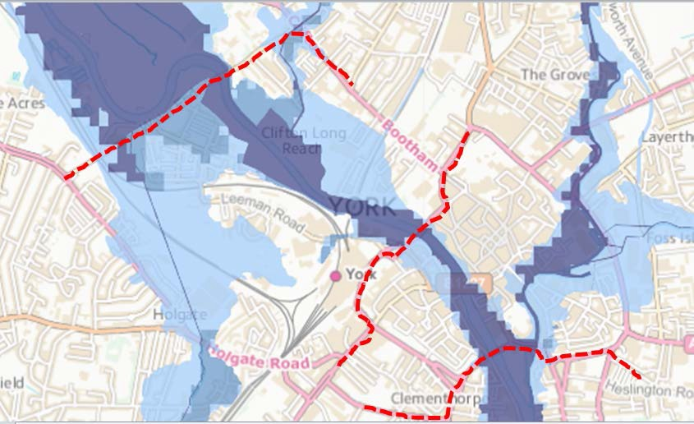
Opportunistic sampling
Transects do NOT need to be straight.
In urban areas they will follow roads/paths which is an example of opportunistic sampling.

Slide 9
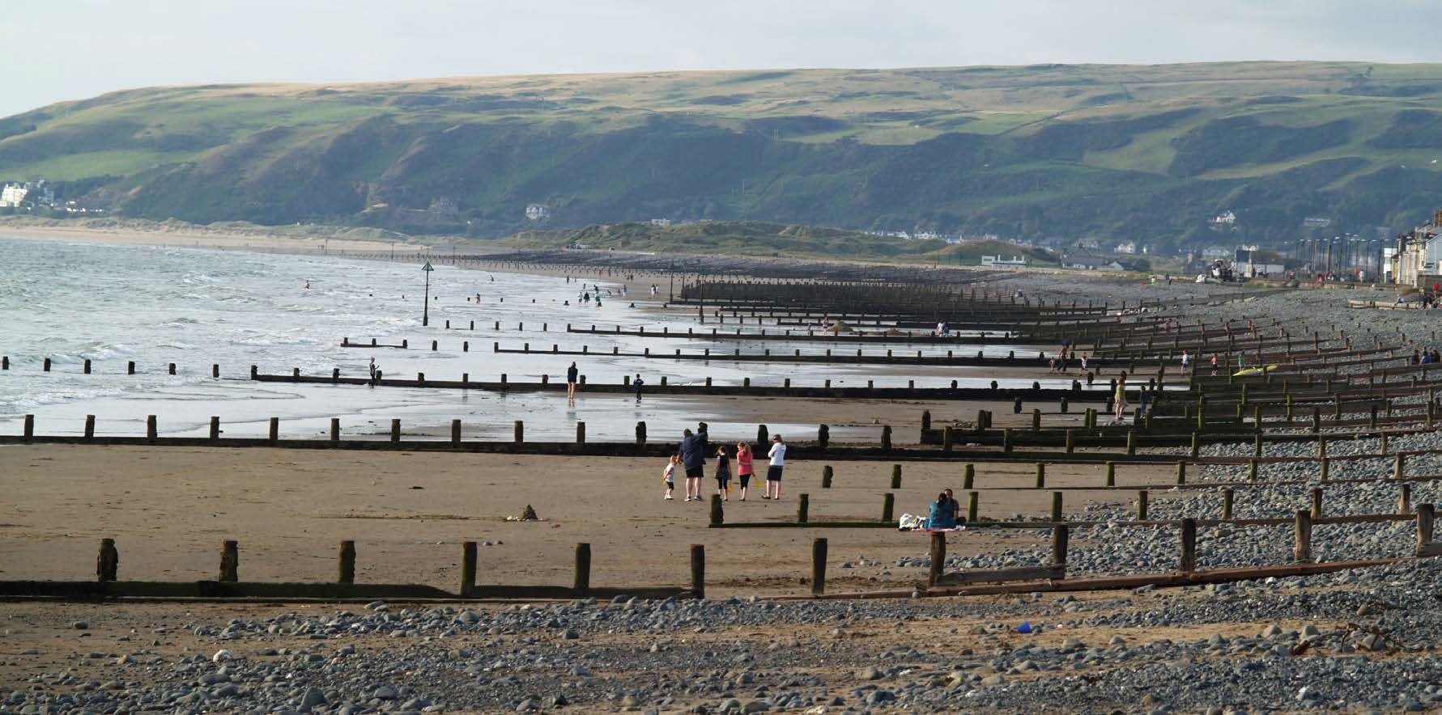













Can I survey along a river or along a beach?
Can I survey along a river or along a beach?
YES Survey lines can be used longitudinally i.e. following the length of a geographical feature. You might use this type of survey to study:
downstream changes in a river.
the affect of longshore drift on pebble sizes along a stretch of coastline. The principles of sampling along a line are very similar in longitudinal and transect surveys so either is acceptable.
F
E
D
C B
A

Slide 10
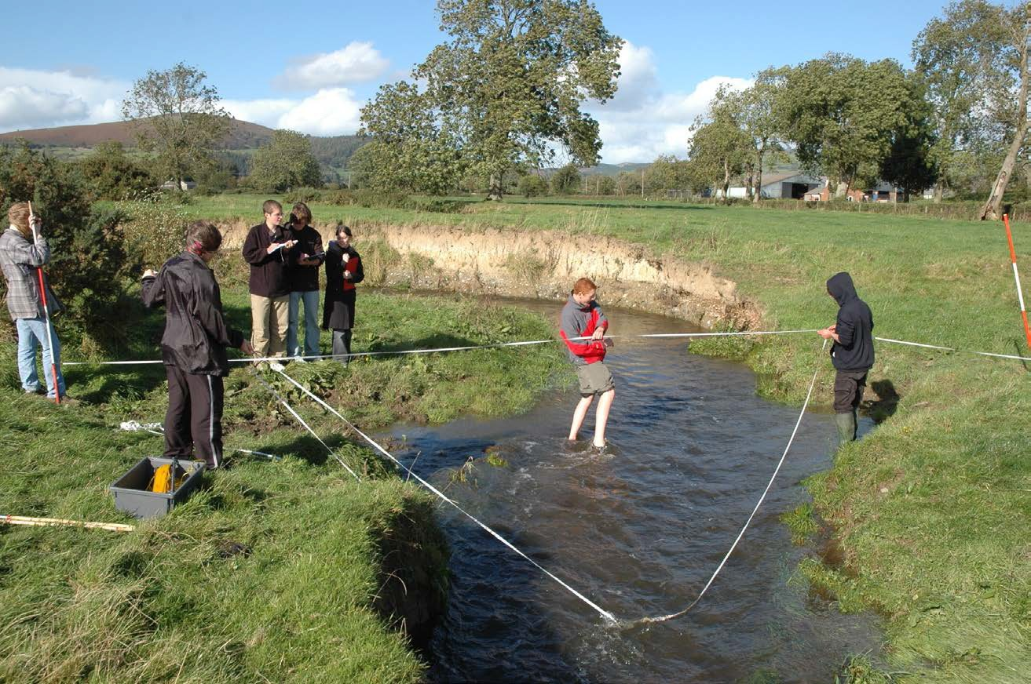
Are cross sections transects?
YES! A river cross section is used to record changes across the river channel
– so it qualifies as a type of transect.
A beach profile is used to record changes in slope angle and pebble size across a beach – so it also qualifies as a type of transect.

Slide 11
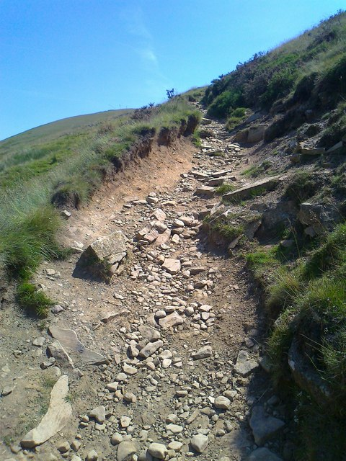
Cross section of footpath is a transect.
A
E
B
D
C
This can be used to investigate change across the path in response to recreation and leisure use.

Slide 12
Cwestiynau? | Any Questions?
Cysylltwch â’n Swyddogion Pwnc arbenigol a thîm cefnogaeth weinyddol eich pwnc os oes gennych unrhyw gwestiynau.
GCSEGeography@wjec.co.uk
@wjec_cbac
@cbac_wjec
cbac.co.uk
wjec.co.uk
Contact our specialist Subject Officers and administrative support team for your subject with any queries.

